Slide 1
Chapter 23
Cable connectivity issues and tools

Slide 2
Specifications and Limitations
Throughput
Capabilities are ever increasing
AWS datacenters operate at petabyte speeds
Speed Distance
Higher speeds are more sensitive to distance
Optical cable have overcome this but are very expensive
Cable considerations
Shielded vs Unshielded
Both are twisted pair cables to reduce the effects of crosstalk and noise
Shielded adds a layer of foil or mesh shielding to protect against electromagnetic interference
Plenum and riser-rated
Used inside buildings
Plenum are fire resistant and have low fume emittance and can be use din air ducts
Riser cables are cheaper and can be used to run between floors that don’t traverse air ducts
Cable Application
Rollover/console cable
Crossover Cable
Power over Ethernet
Notes:
Rollover cable: reverse the pin out on the other end
Crossover cable: Like devices; T568A + T568B

Slide 3
Common issues
Attenuation
Interference
EMI/RFI
Decibel (dB) loss
Measure of signal loss
To much loss end to end may cause link failure
Incorrect pinout
Bad ports
Open/short
Physical fault in the cable
Notes:
Attenuation: 100m distance meaning the closer you are to that 100m, the more your signal degrades
dB: how much of the transmission is lost in transit to its destination (UPC vs APC)
Bad ports can lead to CRC errors

Slide 4
Common issues
Light emitting diode (LED) status indicators
Incorrect transceivers
Convert signals from devices to cabling requirements-
Duplexing issues
Transmit and received (TX/RX) reversed
Dirty optical cables
Bent Pins
Split Pairs
Wire pairs connected to the wrong pair on the other end
Notes:
Dirty Optical cables: dirty fiber optic cables

Slide 5
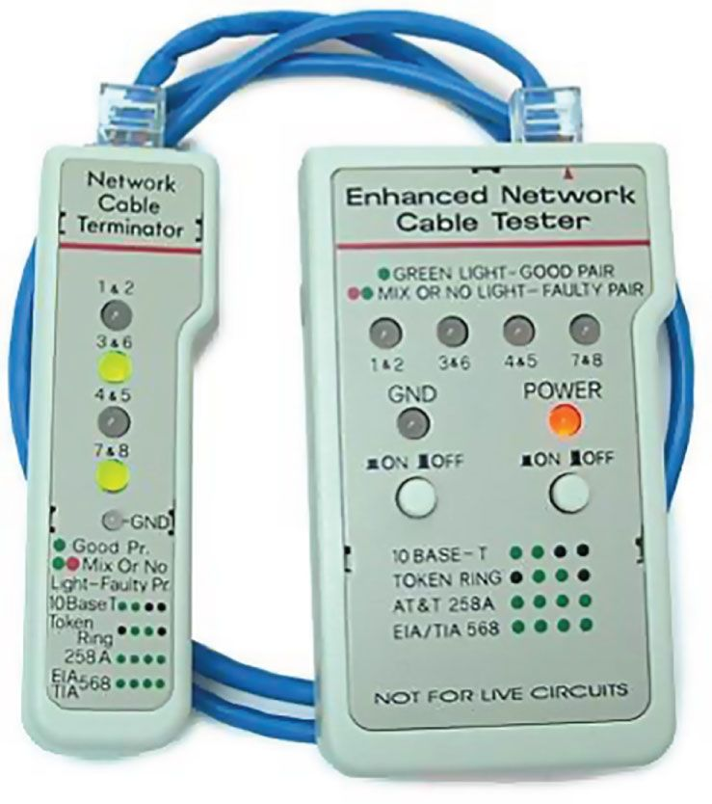
Hardware Tools
Cable Testers
Cable-testing tools can range from simple, inexpensive mechanical devices to elaborate electronic testers that automatically supply you with test results.
An inexpensive cable tester

Slide 6
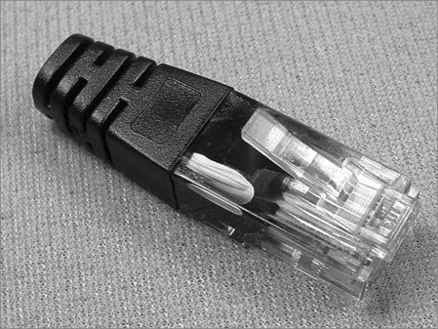
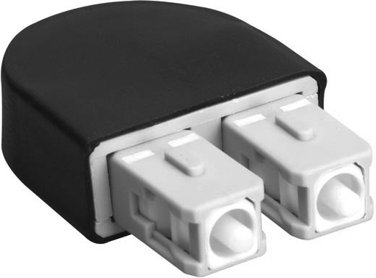
Loopback Plug
A loopback test is a diagnostic procedure in which a signal is transmitted and returned to the sending device after passing through all or a portion of a network or circuit.

Slide 7
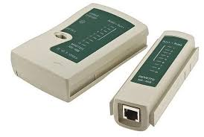
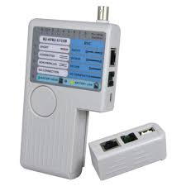
Hardware Tools
Wire-Map Testers
A wire-map tester is a device that transmits signals through each wire in a copper twisted-pair cable to determine if it’s connected to the correct pin at the other end.
Continuity Testers
A continuity tester is an even simpler and less expensive device than a wire-map tester that’s designed to check a copper cable connection for basic installation problems like opens, shorts, and crossed pairs.

Slide 8

Hardware Tools
Protocol Analyzer
A protocol analyzer is often confused with a packet sniffer because some products really are both.
A packet sniffer looks at all traffic on a network segment.
A protocol analyzer analyzes protocols.
Certifiers
Certification testers or certifiers are used to determine whether your network meets specific International Organization for Standardization (ISO) or TIA standards.
Notes:
Protocol analyzer: Wire-shark

Slide 9
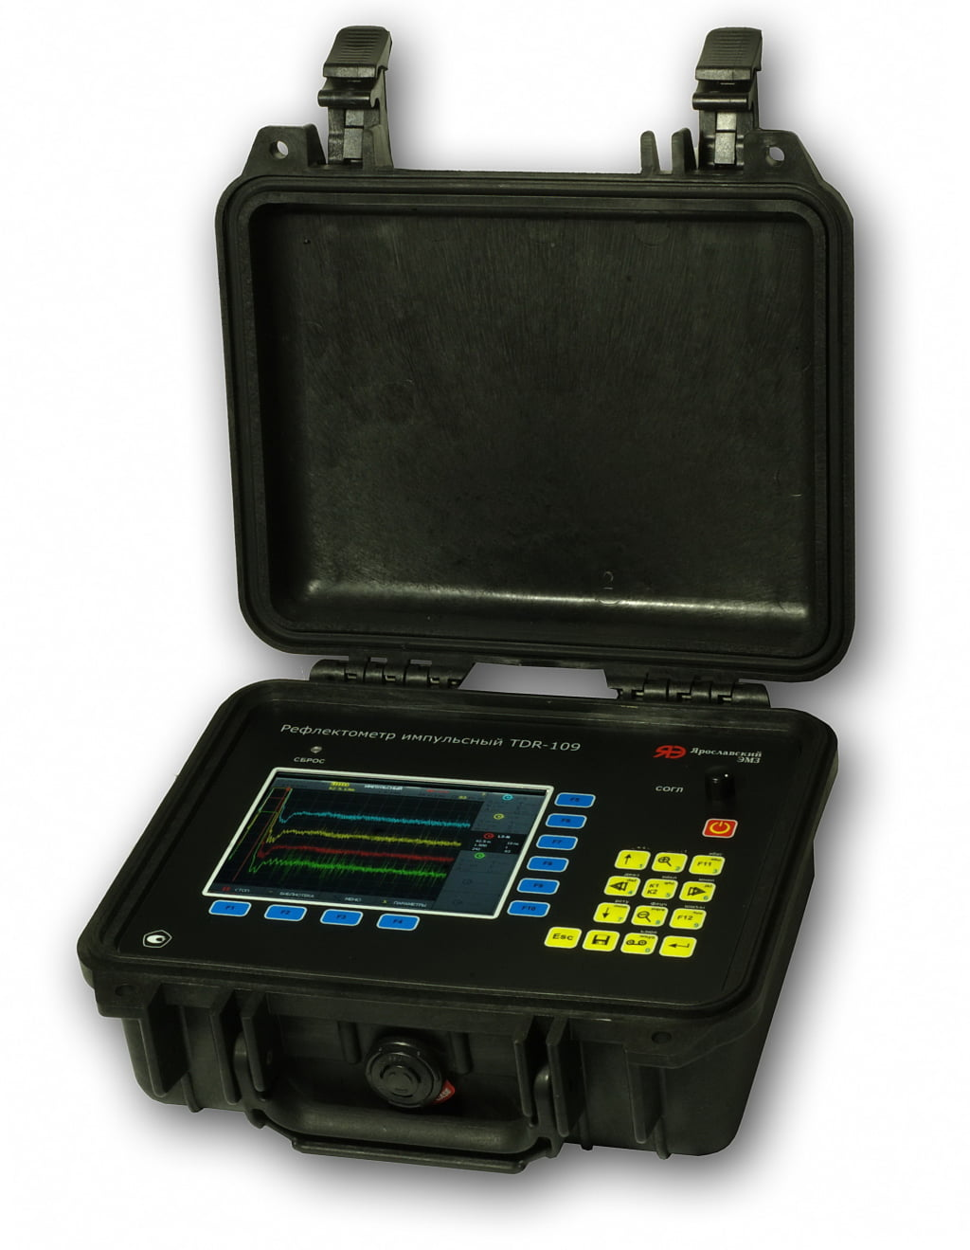
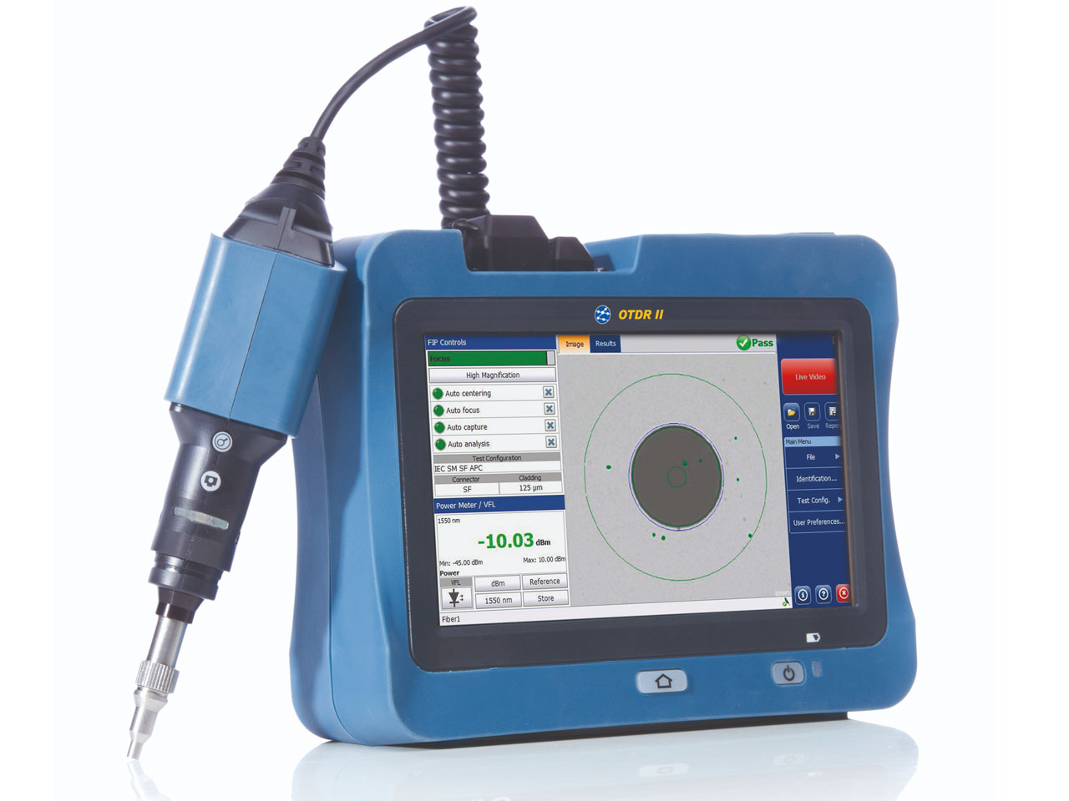
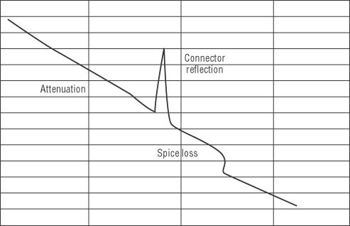
Hardware Tools
Time-Domain Reflectometer (TDR)
A time-domain reflectometer (TDR) is a tool that finds and describes faults in metallic cables like twisted wire pairs and coaxial cables.
Optical Time-Domain Reflectometer (OTDR)
An optical time-domain reflectometer (OTDR) is an optoelectronic instrument used to give you information about optical fibers.
We use OTDRs to give us information about the following:
The fiber’s estimated length
Its overall attenuation
The location of faults
Notes:
TDR finds faults in twisted wire pairs and coaxial cables
OTDR: same thing, but for fiber

Slide 10
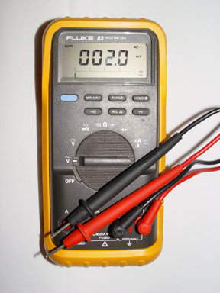
Hardware Tools
Multimeter
A multimeter or a multitester (also called a volt/ohm meter [VOM]) is a multitasking electronic measuring instrument.
Used to troubleshoot electrical problems in a wide array of electrical devices like batteries, motor controls, appliances, power supplies, and wiring

Slide 11
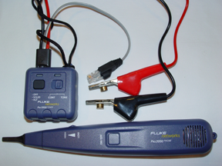
Hardware Tools
Toner Probe
A toner probe, also called a tone generator, is a simple copper cable tester that is simple to use and can be used to trace a wire in a wall.

Slide 12
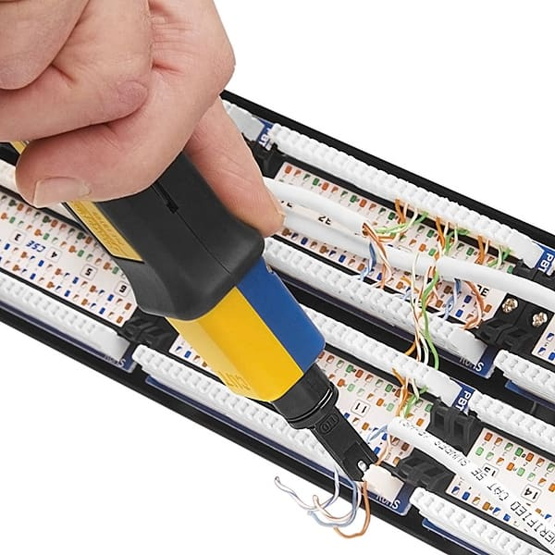
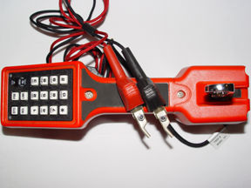
Hardware Tools
Butt Set
A butt set is essentially a portable telephone that allows you to test and monitor analog lines.
Punch-Down Tool
Twisted-pair cable usually terminated in wiring closets using a tool known as a punch-down tool.

Slide 13
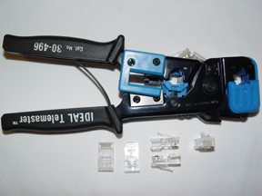
Hardware Tools
Crimper
A wire crimper, often simply called crimper, is a handy tool found in most network technicians’ tool bags.
Crimpers are primarily used for attaching ends onto different types of network cables via a process known as crimping.
Cable Stripper/Snips
Before you can crimp a connector onto the end of a wire, you have to strip the cable with a type of cable stripper (or snips) and then properly put the wires into the connector.

Slide 14
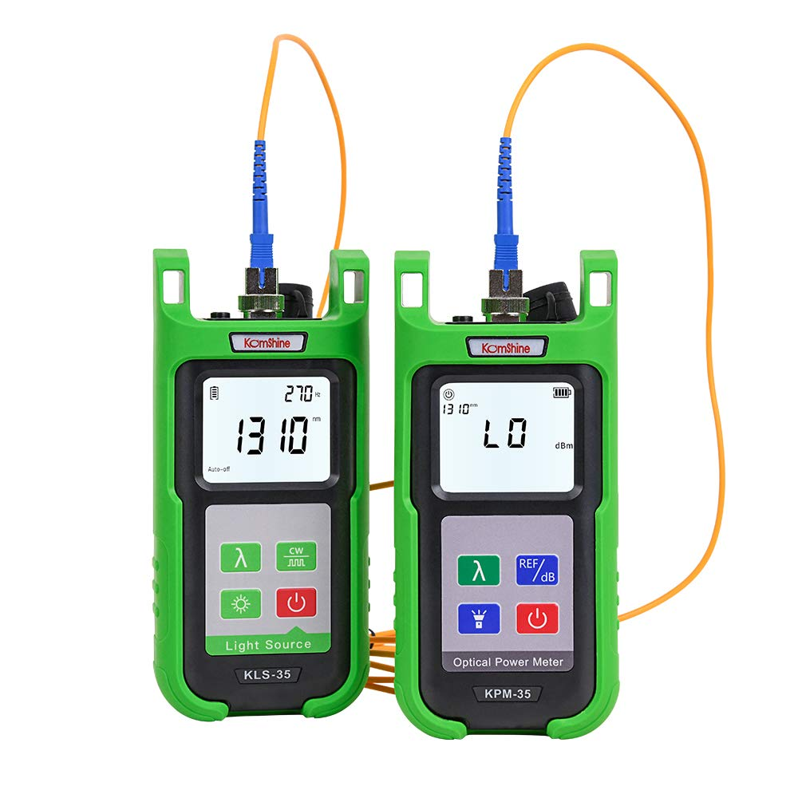
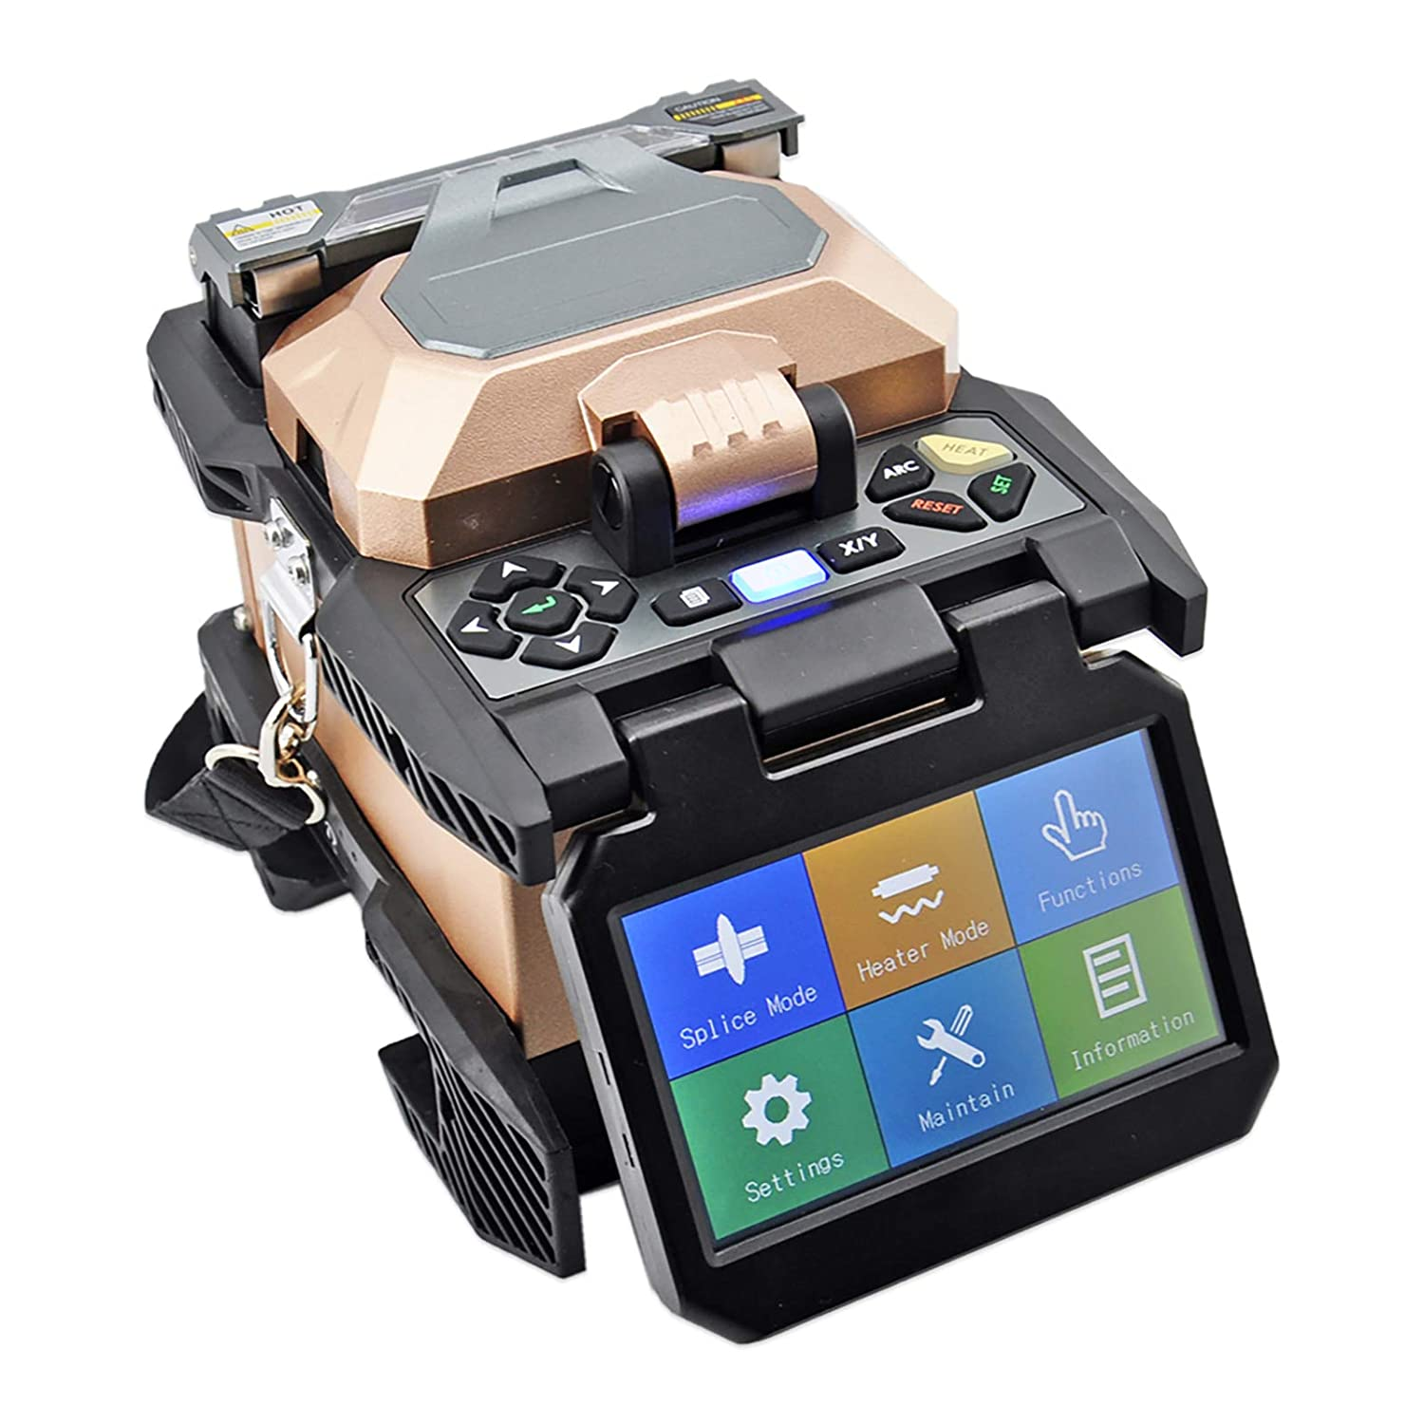
Hardware Tools
Fiber Light Meter
Measure receives levels and wavelengths to verify cable is working
Fiber Fusion Splicer
Used to repair fiber cables
Minimizes light scattering or being reflected back in the cable

